Slide 1
Module -II

Slide 2

Course Objective
1. To understand the concepts of File system and structure of the database; Designing an Entity-Relationship model for a real-life application and Mapping a database schema from the ER model.
2. To differentiate various normal forms, evaluate relational schemas for design qualities and optimize a query.
3. To impart the working methodologies of transaction management, understand concurrency control, recovery, indexing, access methods and fundamental view on unstructured data and its management.

Slide 3

On completion of this course, student should be able to:
1. Comprehend the role of database management system in an organization and design the structure and operation of the relational data model.
2. Develop a database project depending on the business requirements, considering various design issues.
3. List the concepts of indexing and accessing methods.
4. Explain the concept of a database transaction processing and comprehend the concept of database facilities including concurrency control, backup and recovery.
5. Review the fundamental view on unstructured data and describe other emerging database technologies.

Slide 4
ER Model
Database application – database and associated programs that implements database queries and updates
Major part of database application development involves application programs.
Application programs design, implementation comes under software engineering
Conceptual database design
Data structure and constraints considered during conceptual design
Entity – relationship (ER) model is a high level conceptual data model

Slide 5
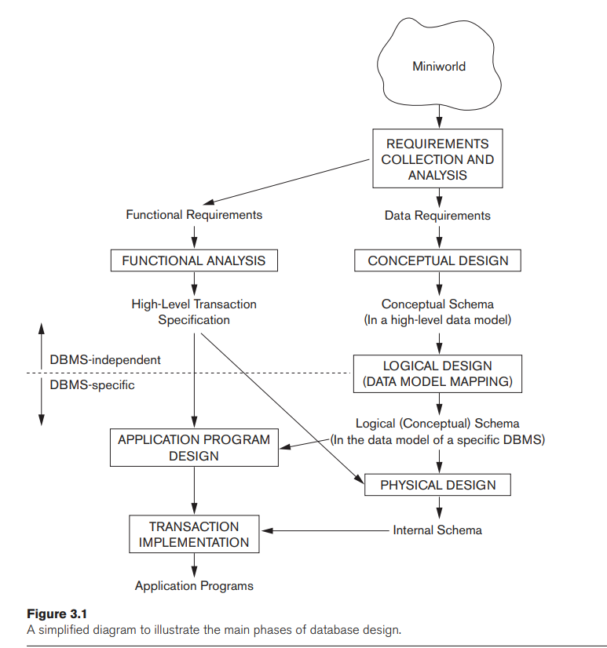
Using High-Level Conceptual Data Models for Database Design

Slide 6
Using High-Level Conceptual Data Models for Database Design
Step1: Requirement collection and analysis
the database designers interview prospective database users to understand and document their data requirements
In Parallel, acquire functional requirements
Functional requirements – user defined operations( or transactions) which is applied to the database like updates and retrieval
In software design, DFD, sequence diagrams, scenarios are used to specify functional requirements
Step 2: Creation of conceptual schema for the database
description of the data requirements of the users - detailed descriptions of the entity types, relationships, and constraints; and are expressed by the high-level data model
It is also to ensure that all users’ data requirements are met and that the requirements do not conflict

Slide 7
Using High-Level Conceptual Data Models for Database Design
Step 3: implementation of database
the conceptual schema is transformed from the high-level data model into the implementation data model.
This step is called logical design or data model mapping; ; its result is a database schema in the implementation data model of the DBMS
Step 4 : Physical design phase
internal storage structures, file organizations, indexes, access paths, and physical design parameters for the database files are specified

Slide 8
Entities and Attributes
Entity-Thing in real world with independent existence
Attributes- Particular properties that describe entity
Types of attributes:
Composite versus simple (atomic) attributes
Single-valued versus multivalued attributes
Stored versus derived attributes
NULL values
Complex attributes

Slide 9
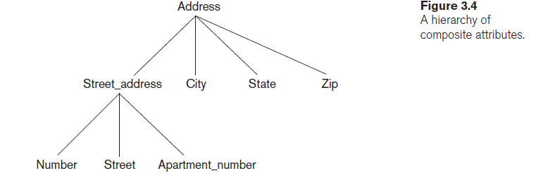
Types of Attributes(simple Vs Composite)
Simple
Attributes that are not divisible are called simple or atomic attributes
Eg : Address
Composite:
Composite attributes can be divided into smaller subparts.
These subparts represent the basic attributes with independent meanings of their own.
eg: Name attributes. can be divided it into sub-parts like First_name, Middle_name, and Last_name.

Slide 10
Types of Attributes
Single-valued versus multivalued attributes
Single- Valued attributes:
single value for a particular entity; such attributes are called single-valued
Age is a single-valued attribute of a person
Multi- Valued attributes:
A multivalued attribute is one that can contain a set of values instead of a single value for a particular entity instance.
Eg: Student with more than one phone number
Stored versus Derived Attributes.
Stored attribute:
A stored attribute is an attribute whose value is physically stored in the database. It is not derived from other attributes.
Eg: DOB
Derived attribute:
A derived attribute is an attribute whose value is calculated or derived from other stored attributes, and not physically stored in the database.
Eg: Age derived from DOB

Slide 11
Types of Attributes
NULL values
Not applicable
Eg: Apartment_number , College_degrees
Unknown
Categories in unknown:
i) Values exists but is missing - for instance, if the Height attribute of a person is listed as NULL
ii) The second case arises when it is not known whether the attribute value exists—for example, if the Home_phone attribute of a person is NULL
Complex Attributes
A complex attribute is an attribute that is a combination of simple attributes and can include multivalued and/or composite attributes.
It is a hierarchical structure of attributes.

Slide 12

Types of Attributes
Complex Attributes
Person
└── ContactInfo (Complex)
├── PhoneNumber (Multivalued)
├── Email (Multivalued)
└── Address (Composite)
├── Street
├── City
├── State
└── Zip

Slide 13
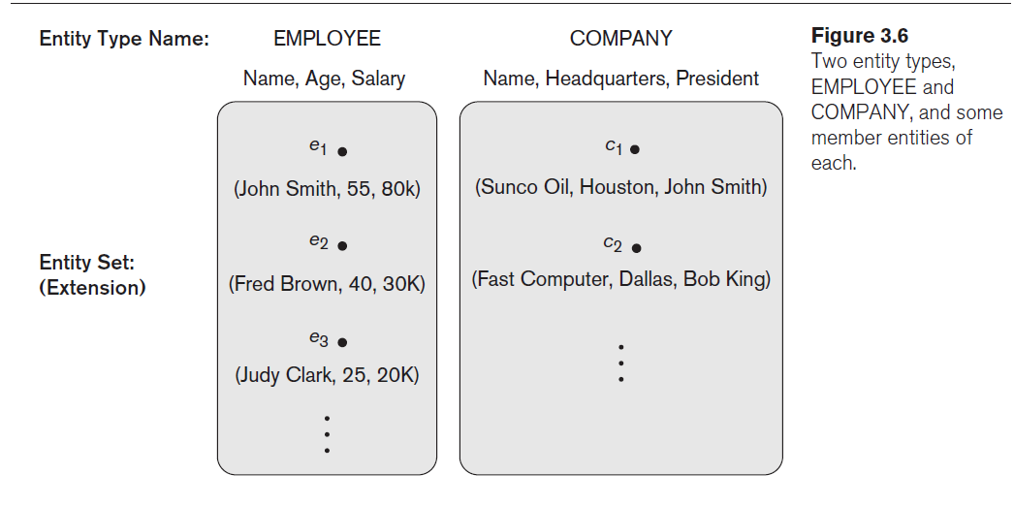
Entity Types, Entity Sets, Keys, and Value Sets
Entity Types
An entity type defines a collection (or set) of entities that have the same attributes
The collection of all entities of a particular entity type in the database at any point in time is called an entity set or entity collection
An entity type describes the schema or intension
Entity set – extension

Slide 14
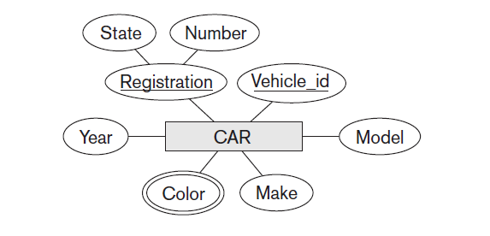
Entity Types, Entity Sets, Keys, and Value Sets
Key Attributes of an Entity Type
constraint on the entities of an entity type is the key or uniqueness constraint on attributes
Key attribute – attribute with distinct values
Value sets ( Domains) of attribute
Not included in ER diagram
Similar to datatypes
Eg:
Common Value Set Types:
Attribute | Value Set (Domain)
Age | {0 – 120}
Name | Set of all alphabetic strings
Email | Set of valid email address formats
Gender | {'Male', 'Female', 'Other'}
DateOfBirth | Valid date values
Grade | {'A', 'B', 'C', 'D', 'F'}

Slide 15
Entity Types, Entity Sets, Keys, and Value Sets
Key Attributes of an Entity Type
constraint on the entities of an entity type is the key or uniqueness constraint on attributes
Key attribute – attribute with distinct values
Value sets ( Domains) of attribute
Not included in ER diagram
Similar to datatypes
Eg:
Common Value Set Types:
Attribute | Value Set (Domain)
Age | {0 – 120}
Name | Set of all alphabetic strings
Email | Set of valid email address formats
Gender | {'Male', 'Female', 'Other'}
DateOfBirth | Valid date values
Grade | {'A', 'B', 'C', 'D', 'F'}

Slide 16
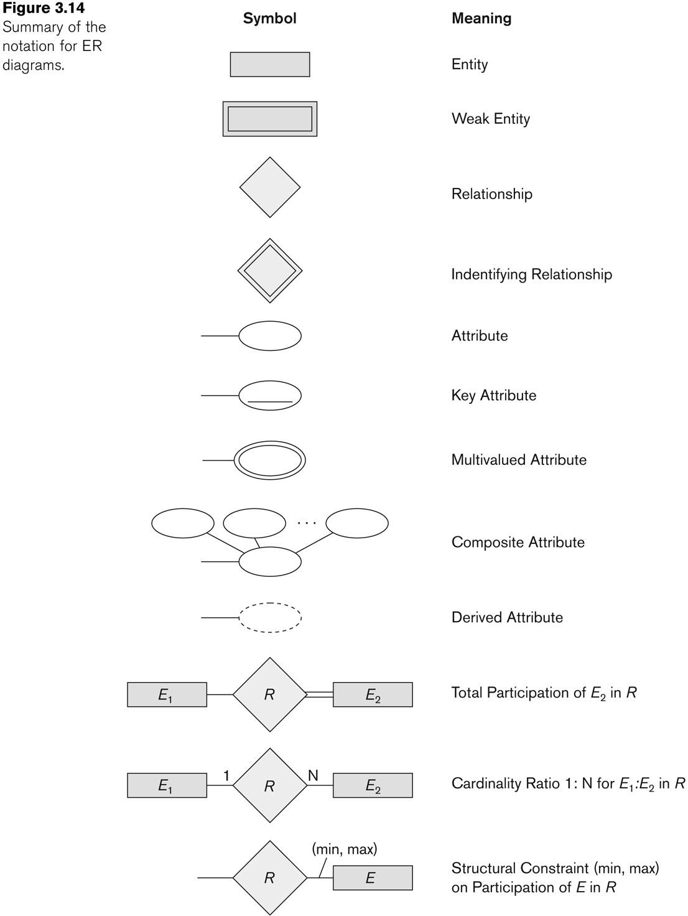
Summary of notation for ER diagrams

Slide 17
Initial Conceptual Design of the COMPANY Database
1. An entity type DEPARTMENT with attributes Name, Number, Locations, Manager, and Manager_start_date. Locations is the only multivalued attribute. We can specify that both Name and Number are (separate) key attributes because each was specified to be unique.
2. An entity type PROJECT with attributes Name, Number, Location, and Controlling_department. Both Name and Number are (separate) key attributes.
3. An entity type EMPLOYEE with attributes Name, Ssn, Sex, Address, Salary, Birth_date, Department, and Supervisor. Both Name and Address may be composite attributes; however, this was not specified in the requirements. We must go back to the users to see if any of them will refer to the individual components of Name—First_name, Middle_initial, Last_name—or of Address. In our example, Name is modeled as a composite attribute, whereas Address is not, presumably after consultation with the users.
4. An entity type DEPENDENT with attributes Employee, Dependent_name, Sex, Birth_date, and Relationship (to the employee).

Slide 18
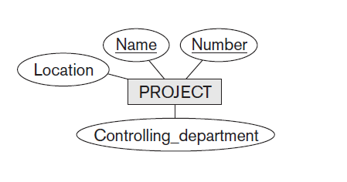
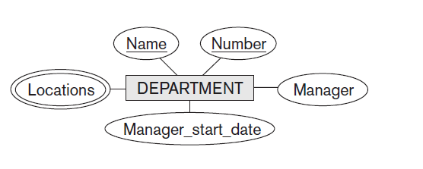
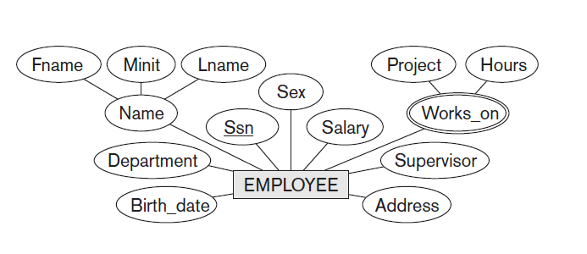
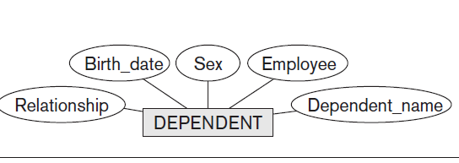
Initial Conceptual Design of the COMPANY Database

Slide 19
Relationship Types, Sets , Roles, and Structural Constraints
Relationship: This is an association between two entities.
whenever an attribute of one entity type refers to another entity type, some relationship exists
References that are not represented as attributes are:
For example, the attribute Manager of DEPARTMENT refers to an employee who manages the department;
the attribute Controlling_department of PROJECT refers to the department that controls the project
Benefits of Relationship
Eliminate data redundancy and inconsistency
maintain data integrity by enforcing referential integrity constraints
efficient querying and retrieval of data ( accessing multiple table with single query)

Slide 20
Relationship Types, Sets , Roles, and Structural Constraints
Relationship type :
A relationship type R among n entity types E1, E2, . . . , En defines a set of associations—or a relationship set—among entities from these entity types.
Each relationship type contains a set of relationships of the same type each satisfying a set of predefined common properties.
One-to-one
One-to-many
Many-to-many
Relationship Type | Description | Example
One-to-One (1:1) | Each entity instance in one set is related to at most one entity instance in the other set. | An Employee has exactly one Employee Contact Info
One-to-Many (1:N) | One entity instance in the first set relates to multiple instances in the second set, but not vice versa. | A Department has many Employees, but each Employee belongs to one Department
Many-to-Many (M:N) | Multiple instances in one set relate to multiple instances in the other set. | Students enroll in many Courses, and Courses have many Students

Slide 21
Relationship Types, Sets , Roles, and Structural Constraints
Relationship set is a set of instances of a relationship type.
If, say, R is a relationship type that relates entity types A and B, then, at any moment in time, the relationship set of R will be a set of ordered pairs (x,y), where x is an instance of A and y is an instance of B.

Slide 22
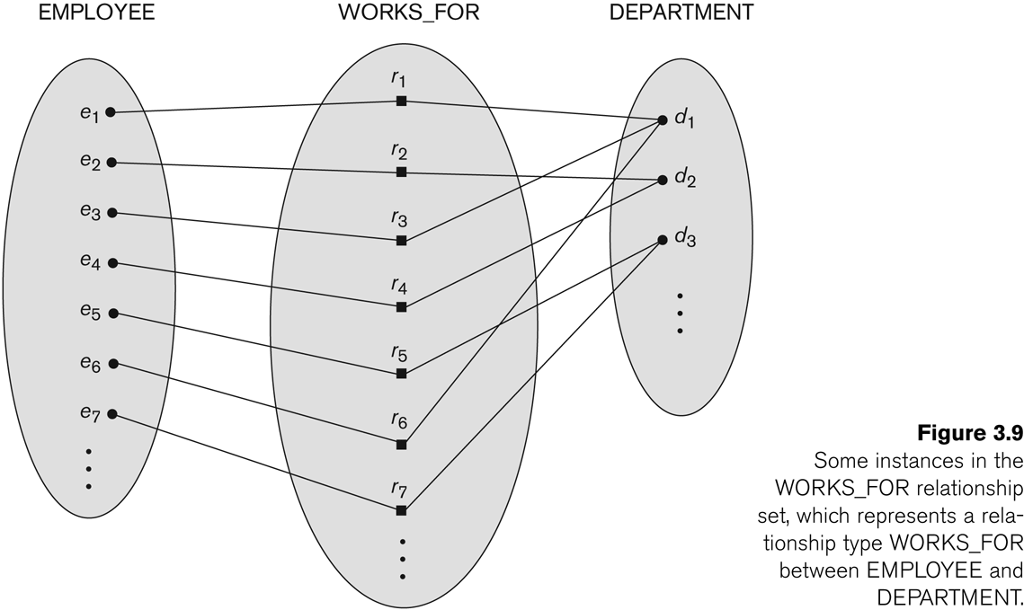
Relationship instances of the WORKS_FOR N:1 relationship between EMPLOYEE and DEPARTMENT

Slide 23
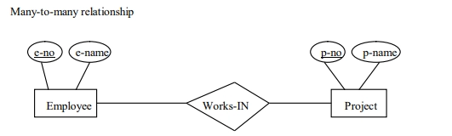
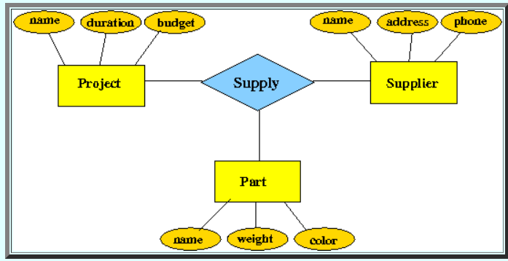
Relationship Degree,Role Names and Recursive Relationships
The degree of a relationship type is the number of participating entity types.
Both MANAGES and WORKS_ON are binary relationships.
Relationships with degree three (called ternary) or more are also possible, although not as common.

Slide 24
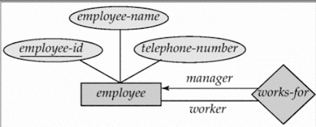
Relationship Degree,Role Names and Recursive Relationships
Roles in relationships: Each entity that participates in a relationship plays a particular role in that relationship, and it is often convenient to refer to that role using an appropriate name.
For example, in each instance of a WORKS_FOR relationship set, the employee entity plays the role of worker or employee and each department plays the role of employer or department.

Slide 25
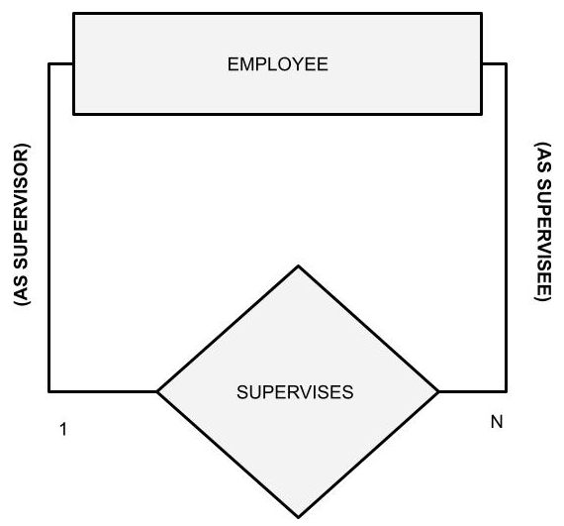
Recursive Relationships
When the same entity type plays two (or more) roles in the same relationship,such relationships are said to be recursive.
Example: the SUPERVISION relationship
EMPLOYEE participates twice in two distinct roles:
supervisor (or boss) role
supervisee (or subordinate) role
Each relationship instance relates two distinct EMPLOYEE entities:
One employee in supervisor role
One employee in supervisee role

Slide 26
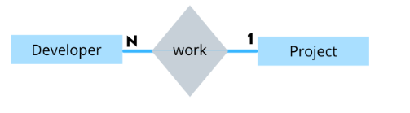
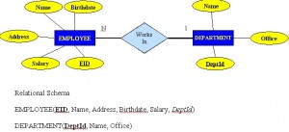
Constraints on Relationships
Constraints on Relationship Types
(Also known as ratio constraints)
Cardinality Ratio (specifies maximum participation)
One-to-one (1:1)
One-to-many (1:N) or Many-to-one (N:1)

Slide 27
Constraints on Relationships
Constraints on Relationship Types
Many-to-many (M:N)
Existence Dependency Constraint (specifies minimum participation) (also called participation constraint)
zero (optional participation, not existence-dependent)
one or more (mandatory participation, existence-dependent)

Slide 28
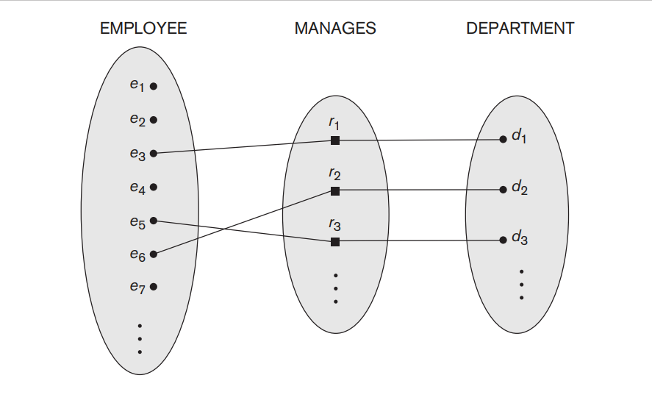
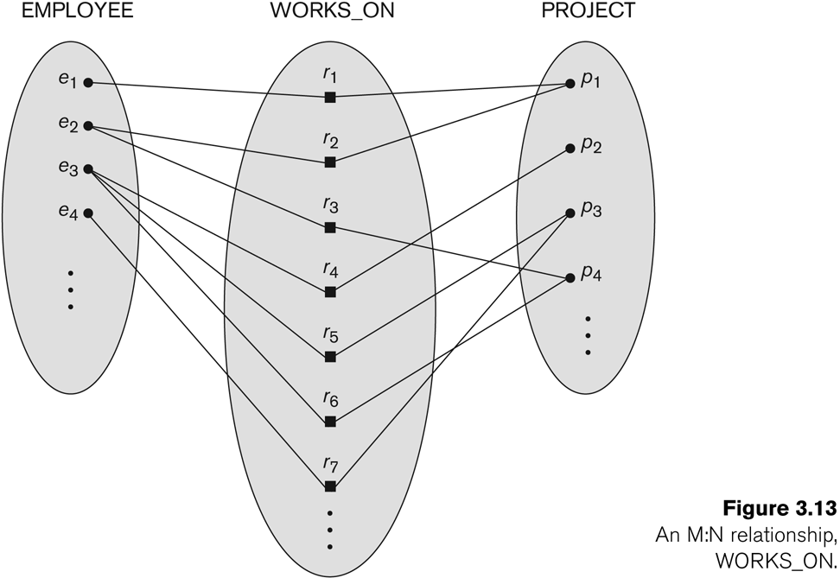
1:1 relationship

Slide 29
Participation Constraints and Existence Dependencies
The participation constraint specifies whether the existence of an entity depends on its being related to another entity via the relationship type
Constraint which specifies the minimum number of relationship instances that each entity can participate in and is called the minimum cardinality constraint
Types of participation constraint
Total partition / existence dependency : Eg: every employee must work for a department, then an employee entity can exist only if it participates in at least one WORKS_FOR relationship instance
Partial participation : eg: not every employee need to manage a department
Cardinality ratio and participation constraints together considered as structural constraints of a relationship type

Slide 30
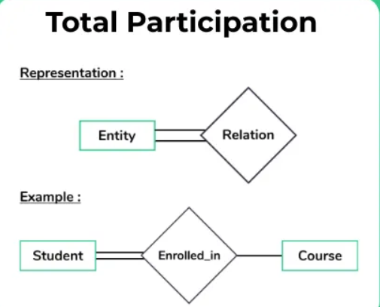
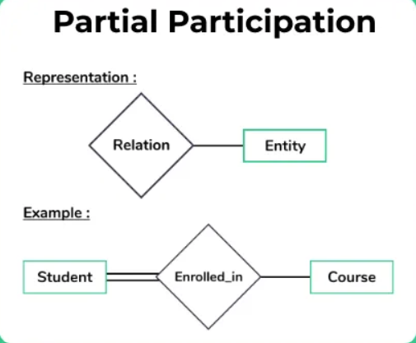
Participation Constraints and Existence Dependencies

Slide 31
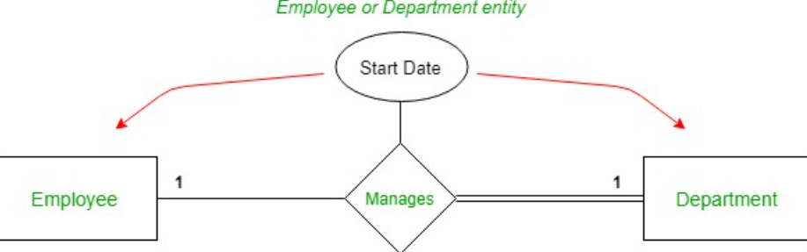
Attributes of Relationship type
Relationship types can also have attributes, similar to those of entity types
Eg: For example, to record the number of hours per week that a particular employee works on a particular project, an attribute Hours for the WORKS_ON relationship type can be included

Slide 32
Weak Entity Type
Entity types that do not have key attributes of their own are called weak entity types
A weak entity type always has a total participation constraint (existence dependency) with respect to its identifying relationship
Relationship type which involves a weak entity type is called existence dependency relationship type

Slide 33
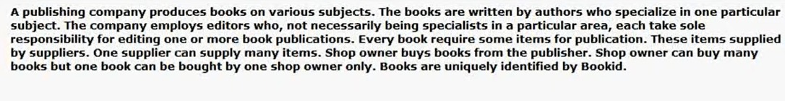
UPS prides itself on having up-to-date information on the processing and current location of each shipped item. To do this, UPS relies on a company-wide information system. Shipped items are the heart of the UPS product tracking information system. Shipped items can be characterized by item number (unique), weight, dimensions, insurance amount, destination, and final delivery date. Shipped items are received into the UPS system at a single retail center. Retail centers are characterized by their type, uniqueID, and address. Shipped items make their way to their destination via one or more standard UPS transportation events (i.e., flights, truck deliveries). These transportation events are characterized by a unique scheduleNumber, a type (e.g, flight, truck), and a deliveryRoute.

Slide 34
Summary of notation for ER diagrams

Slide 35
The company is organized into departments. Each department has a unique name, a unique number, and a particular employee who manages the department. We keep track of the start date when that employee began managing the department. A department may have several locations.
■ A department controls a number of projects, each of which has a unique name, a unique number, and a single location.
■ The database will store each employee’s name, Social Security number,2 address, salary, sex (gender), and birth date. An employee is assigned to one department, but may work on several projects, which are not necessarily controlled by the same department. It is required to keep track of the current number of hours per week that an employee works on each project, as well as the direct supervisor of each employee (who is another employee).
■ The database will keep track of the dependents of each employee for insurance purposes, including each dependent’s first name, sex, birth date, and relationship to the employee

Slide 36
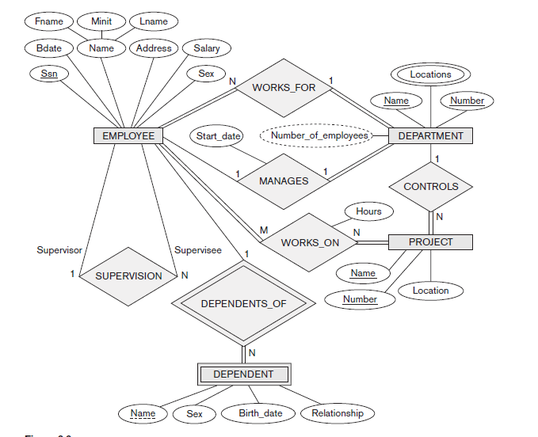

Slide 37
Consider a MOVIE database in which data is recorded about the movie industry. The data requirements are summarized as follows:
■ Each movie is identified by title and year of release. Each movie has a length in minutes. Each has a production company, and each is classified under one or more genres (such as horror, action, drama, and so forth). Each movie has one or more directors and one or more actors appear in it. Each movie also has a plot outline. Finally, each movie has zero or more quotable quotes, each of which is spoken by a particular actor appearing in the movie.
■ Actors are identified by name and date of birth and appear in one or more movies. Each actor has a role in the movie.
■ Directors are also identified by name and date of birth and direct one or more movies. It is possible for a director to act in a movie (including one that he or she may also direct).
■ Production companies are identified by name and each has an address. A production company produces one or more movies.

Slide 38
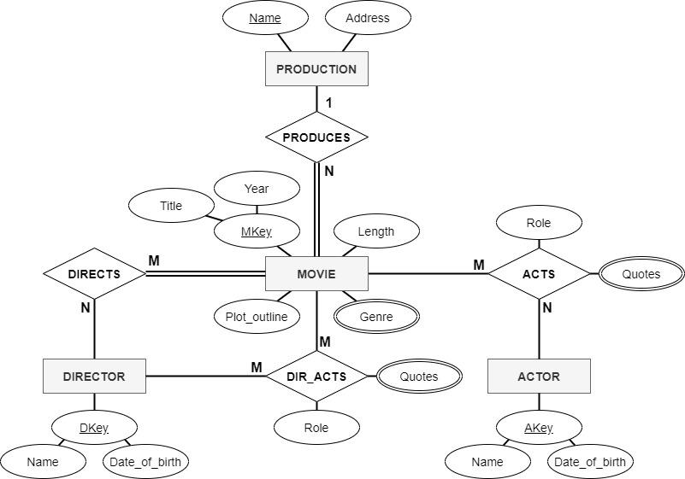

Slide 39
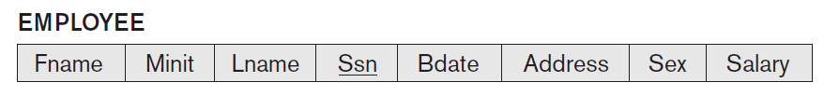
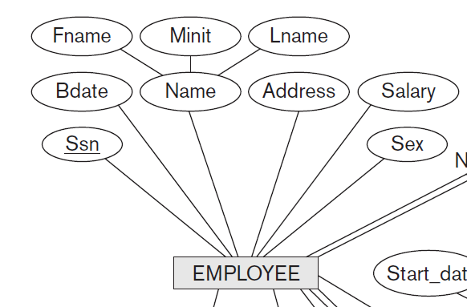
Mapping ER model to a relational schema
Rule -01: Mapping of Regular Entity Types
A strong entity set with only simple attributes will require only one table in relational model.
Attributes of the table will be the attributes of the entity set.
The primary key of the table will be the key attribute of the entity set.
Rule-02: For Strong Entity Set With Composite Attributes
A strong entity set with any number of composite attributes
will require only one table in relational model.
While conversion, simple attributes of the composite attributes
are taken into account and not the composite attribute itself.

Slide 40
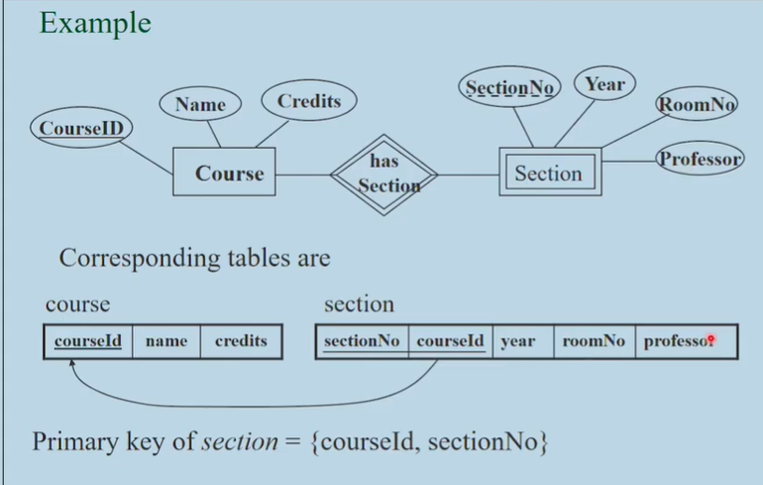
Mapping ER model to a relational schema
Rule 03: Mapping of Weak Entity Type
Rule: For each weak entity set, create a new table.
The table will include:
All the attributes of the weak entity.
The primary key of its identifying (owner) entity.
The combination of the identifying entity's primary key and the weak entity's partial key forms the primary key of the weak entity's table.

Slide 41
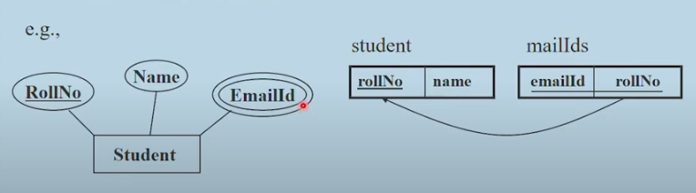
Mapping ER model to a relational schema
Rule 04: For each multi-valued attribute A
Create a new relation R that includes an attribute corresponding to A plus the primary key attribute K (as a foreign key in R) of the relation that represents the entity type or relationship type that has A as an attribute.
The primary key of R is the combination of A and K.
If a multi-valued attribute is composite, we include its components.

Slide 42
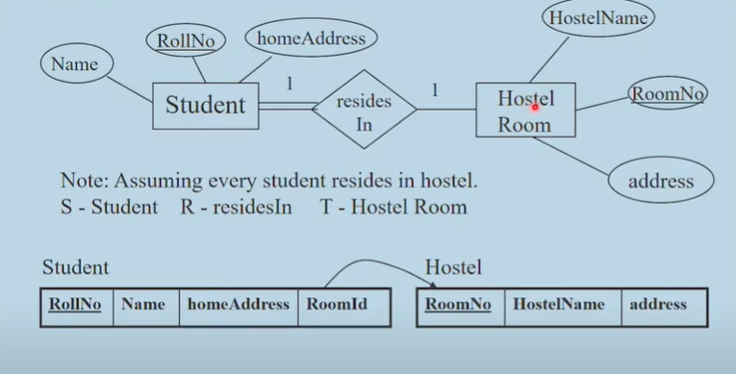
Mapping ER model to a relational schema
Rule 04: Mapping of Binary 1:1 Relationship Types
Identify the relations S and T that correspond to the entity types participating in R. Choose one of the relations, say S, and include as foreign key in S the primary key of T.
It is better to choose an entity type with total participation in R in the role of S.
Include the simple attributes of the 1:1 relationship type R as attributes of S.
If both participations are total, we may merge the two entity types and the relationship into a single relation

Slide 43
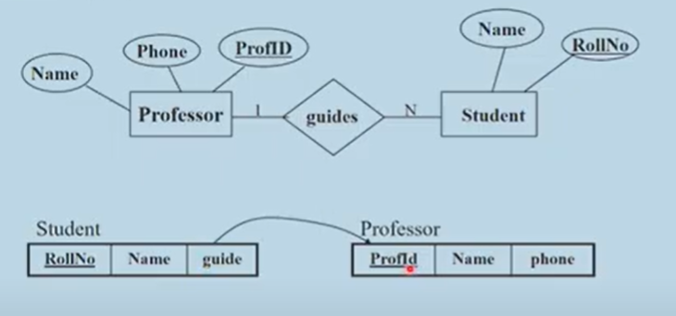
Mapping ER model to a relational schema
Rule 04: Mapping of Binary 1:N Relationship Types
Identify the relation S that represents the participating entity type at the N-side of the relationship type.
Include as foreign key in S the primary key of the relations T that represents the other entity type participating in R.
Include any simple attributes of the 1:N relationship type as attributes of S.

Slide 44
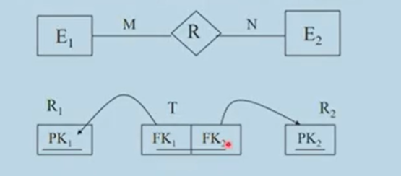
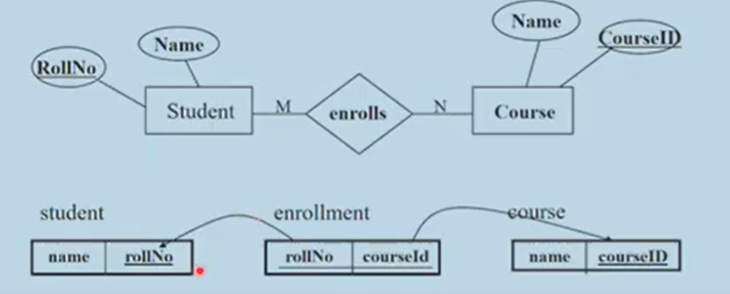
Mapping ER model to a relational schema
Rule 04: Mapping of Binary M:N Relationship Types
Create a new relation S to represent R.
Include as foreign key attributes in S the primary keys of the relations that represent the participating entity types; their combination will form the primary key of S.
Also, include any simple attributes of the M:N relationship type as attributes of S.

Slide 45
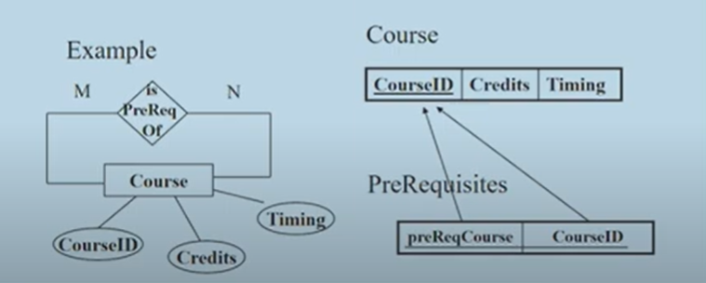
Mapping ER model to a relational schema
Rule 04: Mapping Recursive Relationship
Create a new table T for the participating entity set E ( might be already existing)
And one table recursive relationship R

Slide 46
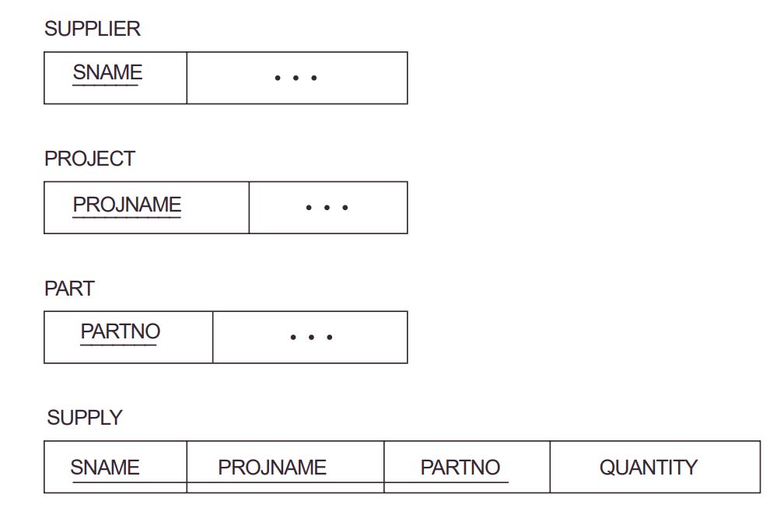
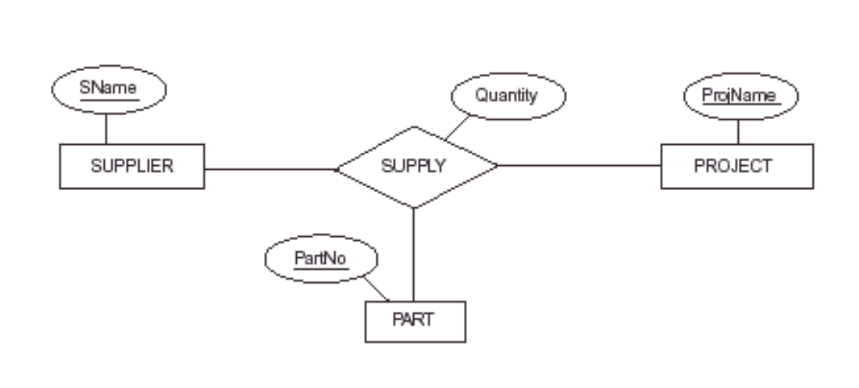
Mapping ER model to a relational schema
Rule 04: For each N-ary relationship type R, n>2
Create a new relation S to represent R.
Include as foreign key attributes in the S the primary keys of the relations that represent the participating entity types.
Also include any simple attributes of the nary relationship types as attributes of S.
The primary key for S is usually a combination of all the foreign keys that reference the relations representing the participating entity types.

Slide 47
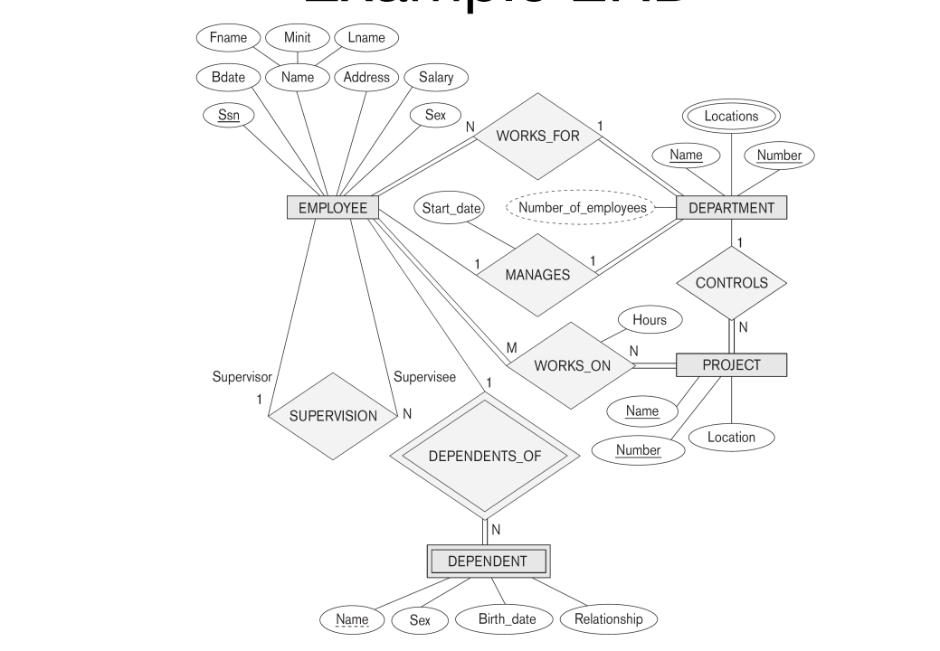

Slide 48
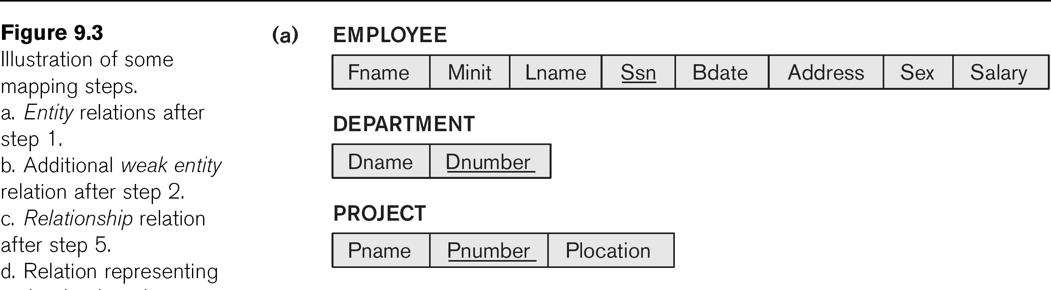
Step 1 Result

Slide 49
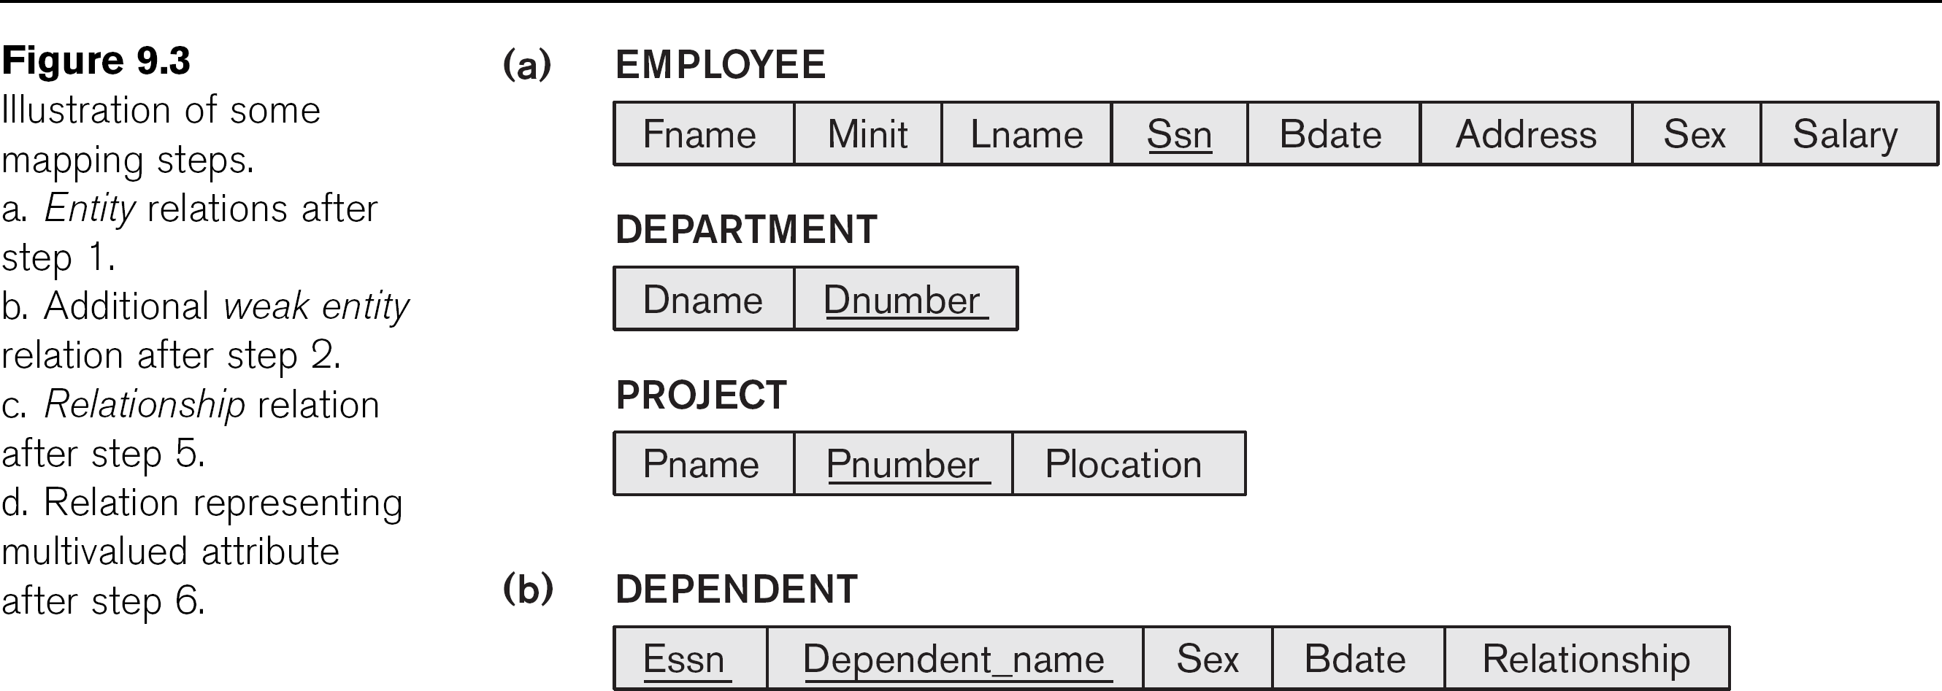
Step 2 Result

Slide 50
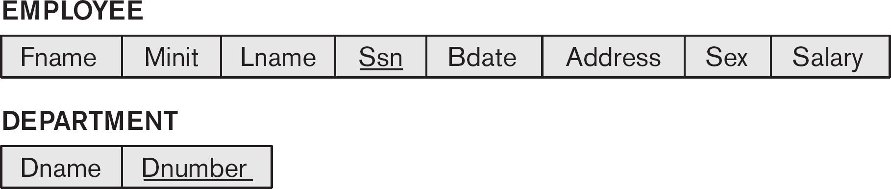
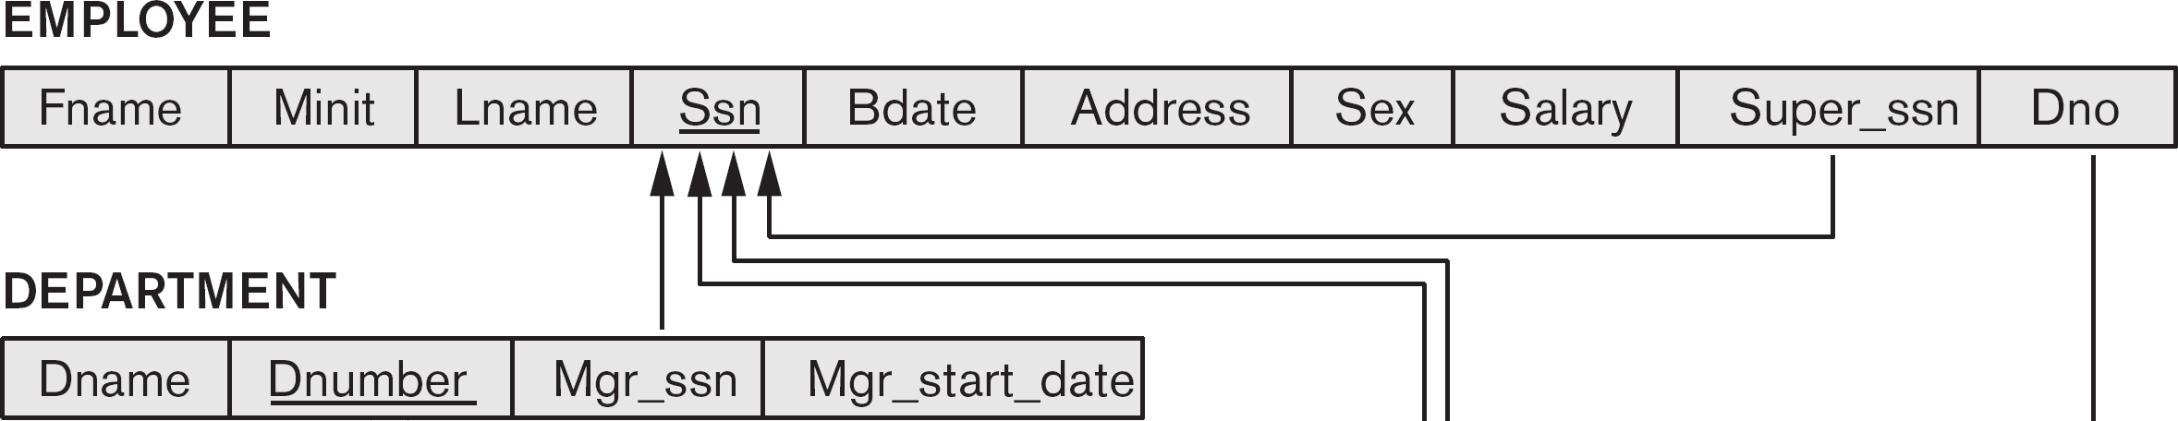
Step 3: Mapping Binary 1-to-1
CS3200 – Database Design· ·· Spring 2018· ·· Derbinsky
Step 2 Result
Step 3 Result

Slide 51
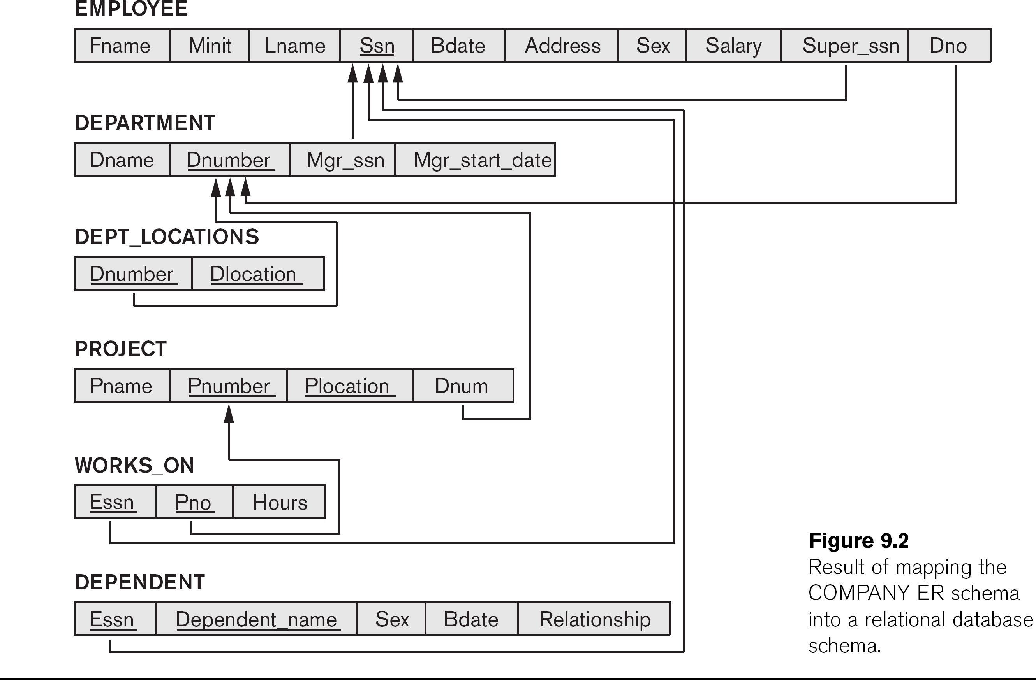
Step 4: Binary 1-N

Slide 52
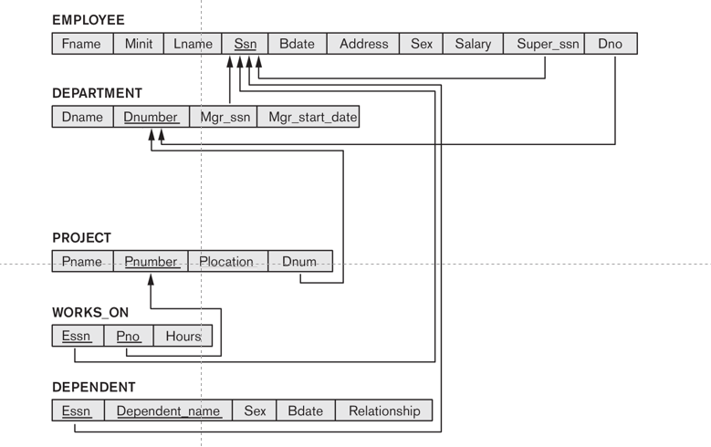
Step 5 : Binary M to N

Slide 53
Step 6: Multivalued Attributes

Slide 54
Enhanced Entity–Relationship (EER) Model
Basic concepts of ER modeling are not sufficient to represent requirements of newer, more complex applications.
The EER model incorporates all the concepts of the basic ER model (entities, attributes, relationships, cardinalities) and extends them with the following powerful features:
SuperClass
SubClass
Generalization
Specialization

Slide 55
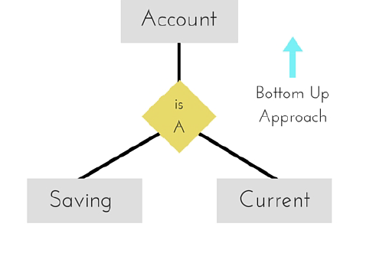
Enhanced Entity–Relationship (EER) Model
Three new concepts were added to the existing ER Model, they were:
Generalization : It is a bottom-up approach in which two lower level entities combine to form a higher level entity.

Slide 56
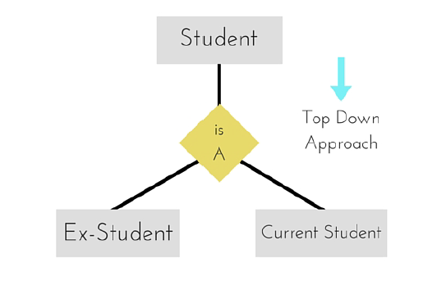
Enhanced Entity–Relationship (EER) Model
Specialization : It is opposite to Generalization. It is a top-down approach in which one higher level entity can be broken down into two lower level entity.

Slide 57
Enhanced Entity–Relationship (EER) Model
Aggregation : It is a process when relation between two entities is treated as a single entity.

Slide 58
Enhanced Entity–Relationship (EER) Model
Constraints on Generalization/ Specialization
Disjointness Constraint: Specifies whether an entity in the superclass can belong to one or more subclasses.
Disjoint (d): An entity can belong to at most one subclass in the specialization (e.g., a "Person" can be either a "Student" or an "Instructor," but not both simultaneously in a given context).
Overlapping (o): An entity can belong to multiple subclasses in the specialization (e.g., a "Person" can be both a "Student" and an "Employee").
Completeness Constraint: Specifies whether every entity in the superclass must belong to at least one subclass in the specialization
Total
Partial
Union Type
Represents a subclass that is a union of objects from different entity types (superclasses). A member of a category must belong to at least one of its superclasses.
Example: An "Owner" category might be formed from the union of "Person" and "Company" entities, as both can own a "Vehicle.

Slide 59
Enhanced Entity–Relationship (EER) Model
Constraints on Generalization/ Specialization
Aggregation:
A concept that allows a relationship set to be treated as a higher-level entity set. This is particularly useful when a relationship itself participates in another relationship.
Example: If "Employee" WORKS_ON "Project" (a relationship), and a "Manager" SUPERVISES these "WORKS_ON" assignments, then WORKS_ON can be aggregated into an entity, and SUPERVISES can be a relationship between "Manager" and the WORKS_ON aggregate.

Slide 60
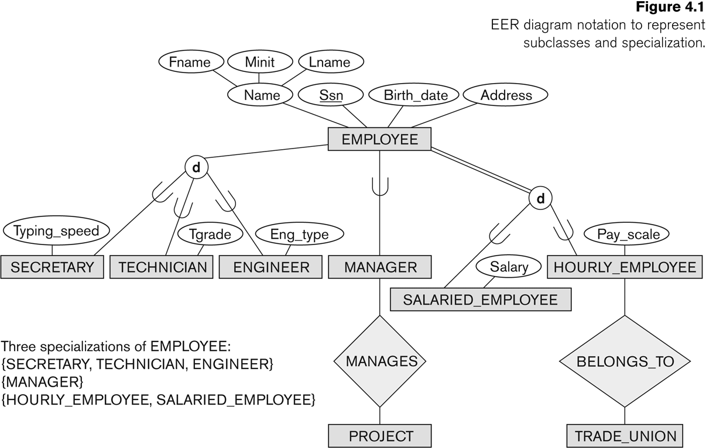

Slide 61
